Slide 1
ID TESTS, METHOD & LIMITS
FOR DIFFERENT INGREDIENT TYPES
Blake
Ebersole
B.S., M.B.A
president

Slide 2
What Constitutes Ingredient ID?
For botanicals:
Scientific name (Camellia sinensis)
Common name (Green tea)
Plant part (Leaf)
Physical form (Powdered extract)
Solvent or type of process (ethanol only)
Potency of a characteristic marker compound and CAS# (40% EGCG)
Ingredient disclosure (contains maltodextrin)
Meets compendial specification (USP, Ph. Eur, AHP)

Slide 3
How to determine appropriate ID -- First understand the following:
Geographic source, variety, climate, storage of raw material
Form of material (whole, cut, powdered, extract)
Manufacturing process (solvents, degree of concentration, type of drying
Potential adulterants (GOOGLE IT!!)
Authentic reference materials
Test materials – not generally verified/authenticated
Botanical reference material, or BRM – Identity Verified
Standard reference materials, or SRM (ideally pure compounds)
Certified reference materials, or CRM

Slide 4
What’s an Authentic Reference?
BRM accompanied by voucher specimen
Authenticated by one or more experts (field collector, botanist)
Voucher information:
Certified by valid scientific methods
Botany (e.g. distinguishing macroscopic and/or microscopic characteristics unique to the species and plant part)
Chemistry (e.g. distinguishing chemical markers unique to the species and plant part)
Certified by a source who can produce evidence of verification
A test material that is not authenticated cannot be a reference material

Slide 5
How to determine appropriate ID
Understand method fitness for purpose -- and therefore its limitations!

Slide 6
ID Rules of Thumb
Multiple test methods are the standard, not the exception: The majority of findings should be replicated (or easily replicable) using a different (“orthogonal”) method. E.g. TLC should be confirmed by HPLC
Reference materials are central: Multiple authenticated BRM of same species from different sources
Look for method to prove absence of common adulterants
Method selection is often based on individual basis
Methods need to be appropriate for type of material

Slide 7
Ingredient ID Methods Chart
Method | Whole plant | Whole plant part | Dehydrate/ Milled plant part | Crude Extract | Purified Extract | Combination Product
Visual/Macroscopy | X | X* | X*
Microscopy |  | X* | X*
Organoleptic (Aroma/Taste) |  | X | X | X | X
IR (FT-IR, NIR) |  |  |  | X | X
TLC, HPTLC |  | X* | X* | X* | depends | depends
LC, GC, MS, NMR |  | X* | X* | X* | X* | X*
DNA |  | X | X
Metabolomic-Chemometric approach | X* | X* | X* | X* | X* | X*
*may be suitable on its own without orthogonal method, case by case basis

Slide 8
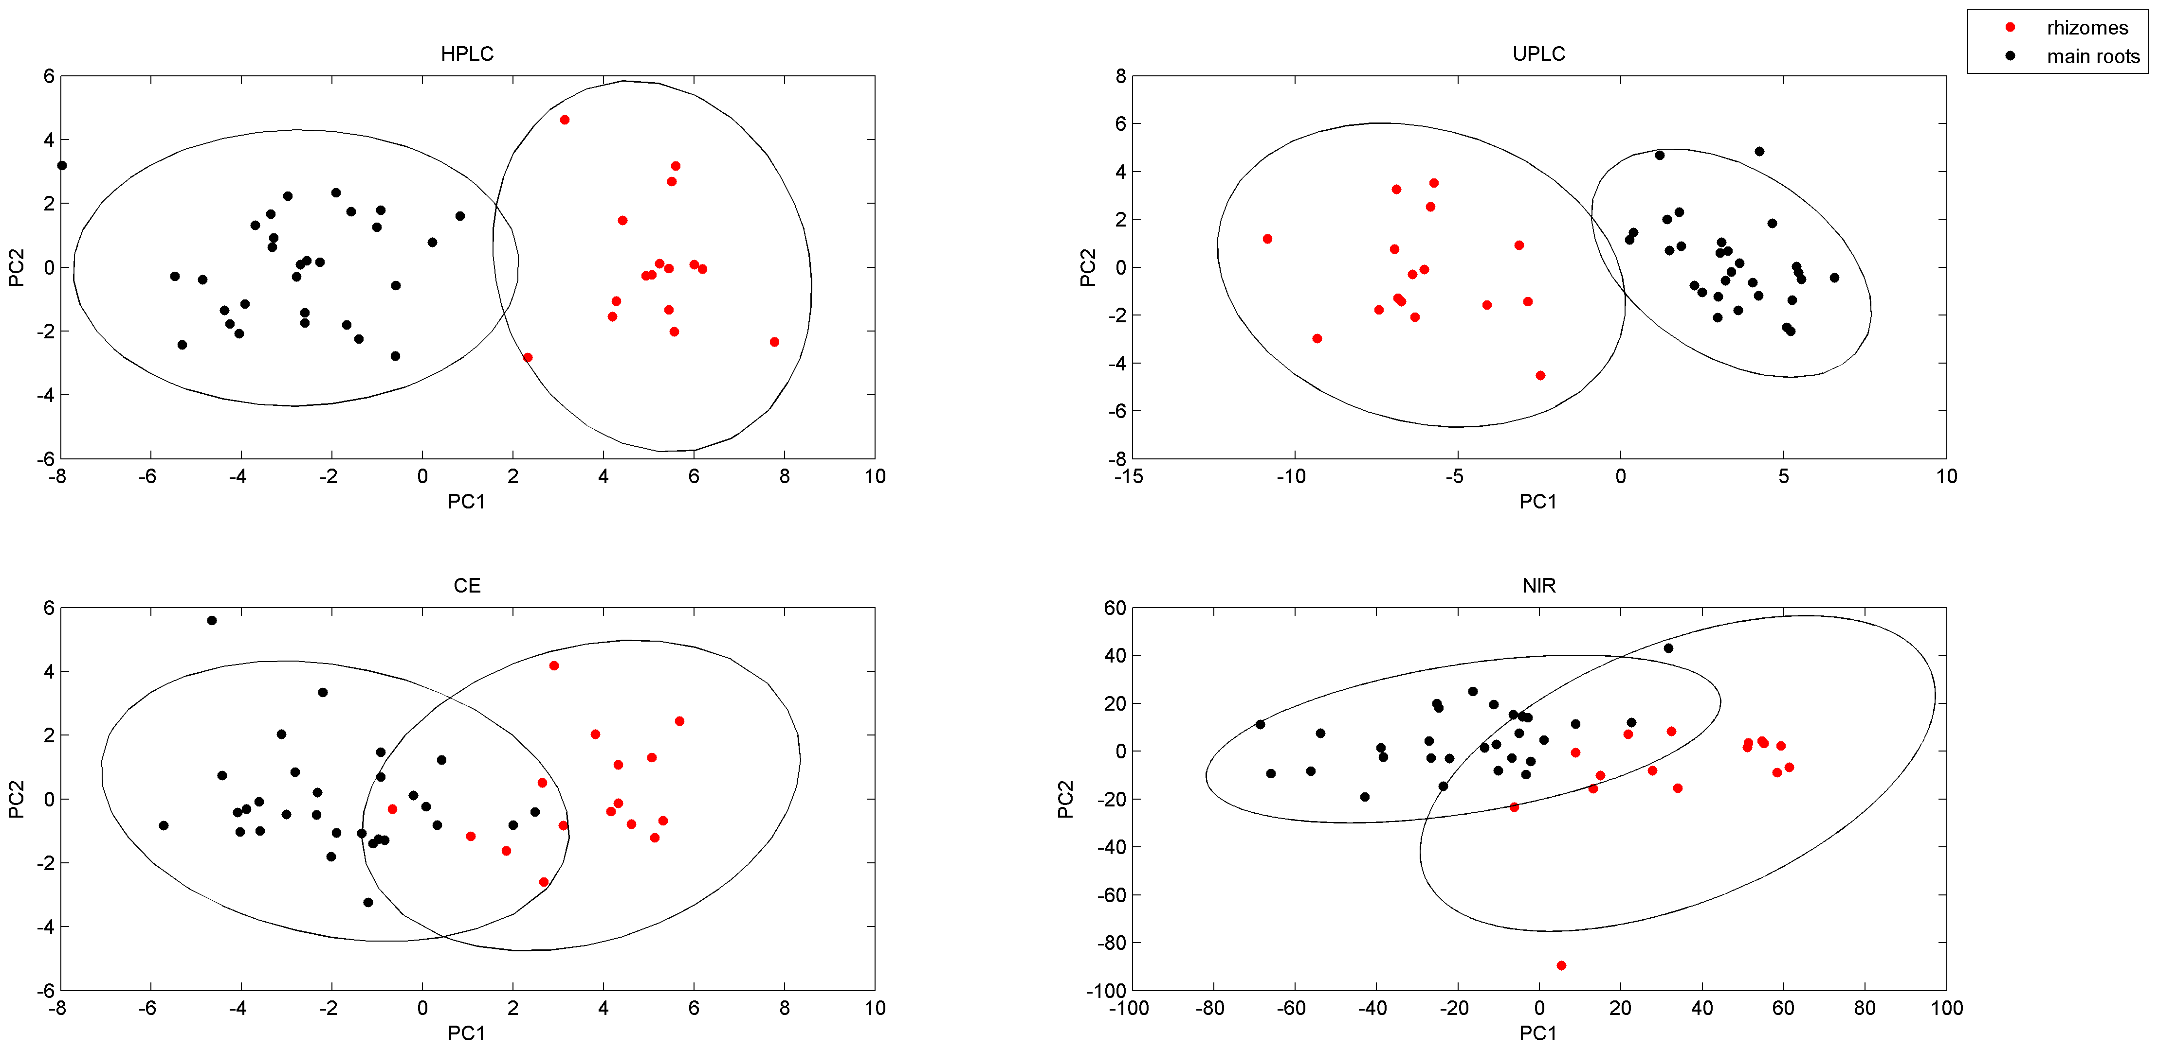
Metabolomic - Chemometric approach
Any chemical method producing spectral or chromatographic data
Principle Component Analysis
Reference library needs to be robust

Slide 9
Method Validity
Master Guidance: AOAC Appendix K
Part I: AOAC Guidelines for Single-Laboratory Validation of Chemical Methods for Dietary Supplements and Botanicals
Part II: AOAC Guidelines for Validation of Botanical Identification Methods
Part III: Probability of Identification: A Statistical Model for the Validation of Qualitative Botanical Identification Methods
Within-lab only
A validated method which changes must be re-validated to determine that the changes did not affect the Standard Method Performance Requirements (SMPR)

Slide 10
Standard Method Performance Requirements (SMPR) for Chemical Methods
Analytical Range (concentration range)
LOQ (Concentration)
Accuracy (Percent recovery)
Repeatability Precision (Percent RSD)
Reproducibility Precision (Percent RSD)

Slide 11
Appendix K, Part I – Validation of a Chemical Method
Requirements:
(1) We know or can assume the chemical identity of the material we are dealing with.
(2) We have a specimen of the material that can be used as a reference to compare the signal produced by the analyte isolated from the product we are examining with the same signal produced by a known amount of the reference analyte (traceable to a stated reference).

Slide 12
Purposes of Method Validation
Appendix K: The primary purpose of validating a method is to show that the method is fit for its intended purpose.
Some purposes are:
(1) Determine how much of a valuable, necessary, or characteristic ingredient is present in a product.
(2) Determine if a product meets specifications.
(3) Determine if a product meets regulatory requirements.
(4) Survey an environment to determine the presence and amount of a component, contaminant, or a nutrient.
(5) Identify a product and/or its components.”

Slide 13
Performance Characteristics – Appendix K
Selectivity (specificity), as the ability to distinguish the analyte from other substances;
Applicability, as the matrices and concentration range of acceptable operation;
Degree of reliability, usually expressed in terms of bias as recovery
Variability as the standard deviation or equivalent terms (relative standard deviation and variance).
Performance Characteristics established in Standard Method Performance Requirements (SMPR)

Slide 14
Typical Steps to Method Validation
Method Verification: Establish the method meets basic sensitivity, linearity, and precision requirements
Applicability and Selectivity
Calibration Curve bracketing expected analytical range
MDL/LOD/LOQ
Some degree of precision: Replicate runs of same sample multiple times (duplicates at least)
Establish Standard Method Performance Requirements (SMPR)
Single Laboratory Validation (SLV)
Accuracy (Spike recovery in matrix)
Precision: 12 duplicates on same sample
Intermediate Precision (precision over different days)
Ruggedness
Certified Reference Materials

Slide 15
Typical Steps to Method Validation, ctd.
4. Expert Panel Review of SLV method and data
5. AOAC First Action Official Method of Analysis (OMA).
6. Interlaboratory collaborative studies using the same method
7. AOAC Final Action OMA

Slide 16
What Methods are typically OMA?
All food compositions:
Vitamins and Minerals
Gluten
GMO
Microbiology
Allergens
Heavy metals
Pesticides
AOAC call for experts: Turmeric and Lutein
Coming in the near future: Mycotoxins, Polychlorinated Biphenyls, Pthalates
Technically, a method needs to be specific to matrix: e.g. Ethanol in Kombucha

Slide 17
Single Laboratory Validation for Ethanol in Kombucha Tea: Linearity

Slide 18
SLV Precision Data

Slide 19
Accuracy: Percent Recovery
Spike recovery of ethanol in control kombucha #2
Spike recovery of ethanol in control kombucha #1

Slide 20
Accuracy + Precision on CRM

Slide 21
Appendix K Part II – Botanical Identity Method (BIM)
“A method that establishes identity specifications for a botanical material and determines, within a specified statistical limit, a binary test result: YES, the test material is a true example of the target botanical material and meets the identity specifications, or NO, it is not the target botanical.
Thus, a BIM answers the question, “Is the test material the same as the target material (Actea racemosa)?” -- not “What is this material?”
In most cases, the method will achieve this goal by comparison of the test material with materials from the inclusivity panel and will return a YES/NO (or, in some cases, a consistent/ nonconsistent) answer.”

Slide 22
Appendix K Part II – BIM
3.4 Exclusivity
Ability of a BIM to correctly reject nontarget botanical materials.
3.5 Exclusivity Sampling Frame (ESF)
A list of practically obtainable nontarget botanical materials that have taxonomic, physical, or chemical composition characteristics similar to the target botanical and must give a negative result when tested by the BIM. (e.g. Actea rubra)
3.8 Inclusivity
Ability of a BIM to correctly identify variants of the target material that meet the identity specification.
3.9 Inclusivity Sampling Frame (ISF)
A list of practically obtainable botanical materials that are expected to give a positive result when tested by the BIM. (e.g. various sources and types of Actea racemosa)
The inclusivity frame should be sufficiently large that the botanical variation is adequately represented. Sources of variation may include, but are not limited to, species, subspecies, cultivar, growing location, growing conditions, growing season, and post-harvest processing.

Slide 24
Appendix K Part II – BIM
3.16 Specified Inferior Test Material (SITM)
A botanical material mixture that has the maximum concentration of target material that is considered unacceptable, as specified by the SMPRs. (e.g. 10% non- A. racemosa DNA)
3.17 Specified Superior Test Material (SSTM)
A botanical material mixture that has the minimum acceptable concentration of the target material, as specified by the SMPR. (e.g. >99% target species DNA)
3.18 Standard Method Performance Requirements (SMPRs)
Performance requirements based on the fitness-for-purpose statement for each method. For BIMs, the SMPRs should include the physical form of the sample, the ISF, the ESF, the SSTM, the SITM, the number of samples for the inclusivity/exclusivity panels, and the desired probability and confidence limits for the method.
Validation Study (SLV)

Slide 25
Lab Pre-qualification
Years in business
Expertise (# of technicians trained in method principles)
Frequency of running method
Use of compendial methods (USP, AOAC, published)
Source of reference standards
OOS procedure
System suitability/SMPR/verification of method validity
Single Laboratory Validation
Certifications (ISO 17025)

Slide 26
Lab Qualification Red Flags
Address cannot be located on Google Maps; key personnel are unidentifiable
Pricing significantly lower than industry standard
Does not use the method frequently
Does not ever run duplicate samples consecutively
Uses internal or proprietary methods; does not readily share method summary and suitability criteria
Does not run a sufficient number of control samples, such as a new calibration curve in the same batch of samples
Cannot provide reference material COA with evidence supporting authenticity
Does not prepare fresh reference standards and calibration curves with every sample

Slide 27
Lab Qualification Red Flags, ctd..
Does not reference to compendial or published methods
Does not share methods upon request
Does not include original test data on reports (chromatograms, etc)
Does not request sufficient information about expected identity of sample
Does not give detailed precautions on sample handling and transporting samples
Does not have a written out-of-specification procedure or checklist that can be shared
Claims ISO 17025 certification but does not specify which methods are certified

Slide 28
How to Reduce ID Testing Rejections:
Verify, Then Trust
Make sure the method is fit for purpose
Get the raw material used to produce the sample, and provide to laboratory with the sample
Communicate full specs to laboratory (at least: country of origin, plant part, solvents used, potency, ingredient disclosure)
Make sure multiple appropriate references are tested with the sample which reflect 1) the population of the species, and 2) any processing that occurs to the sample.
Confirm results with a different (orthogonal) method
Verification of material source, specifications and supplier: ID Verified™, Spec Verified™, Supplier Verified™

Slide 29
Q&A
Blake
Ebersole
B.S., M.B.A
president

